Slide 1
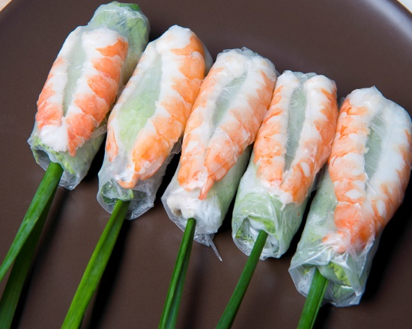
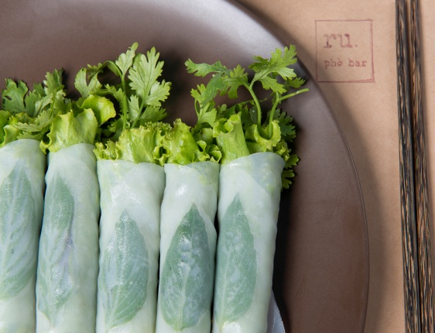
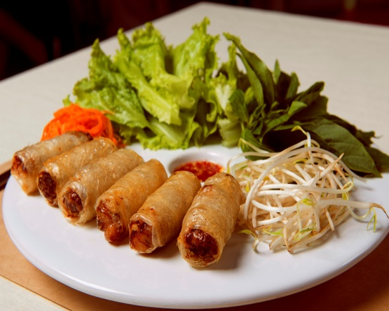
Món Khai Vị – Appetizers
A2
A1
A1. Phở Cuốn (6 Cuốn) / Phở Rolls (6 Rolls) 65,000 VND
Beef Rolls with Lettuce, Cilantro, Vietnamese Basil in Rice Noodle Wrap
A2. Gỏi Cuốn Tôm Thịt (5 Cuốn) / Ru Spring Rolls (5 Rolls) 65,000 VND
With Shrimp, Pork, Lettuce, Vietnamese Basil, Chives in Rice Paper Wrap
A3. Chả Giò (6 Cuốn) / Fried Spring Rolls (6 Rolls) 65,000 VND
With Shrimp, Minced Pork, Carrot, Mushroom, Bean Sprouts, Rice
Vermicelli in Rice Paper Wrap Served with Lettuce
A3
Giá Chưa Bao Gồm 10% VAT
Prices Are Subject to 10% VAT

Slide 2
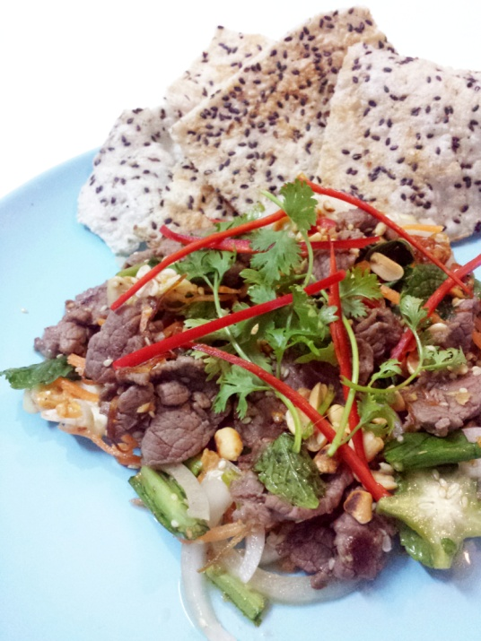
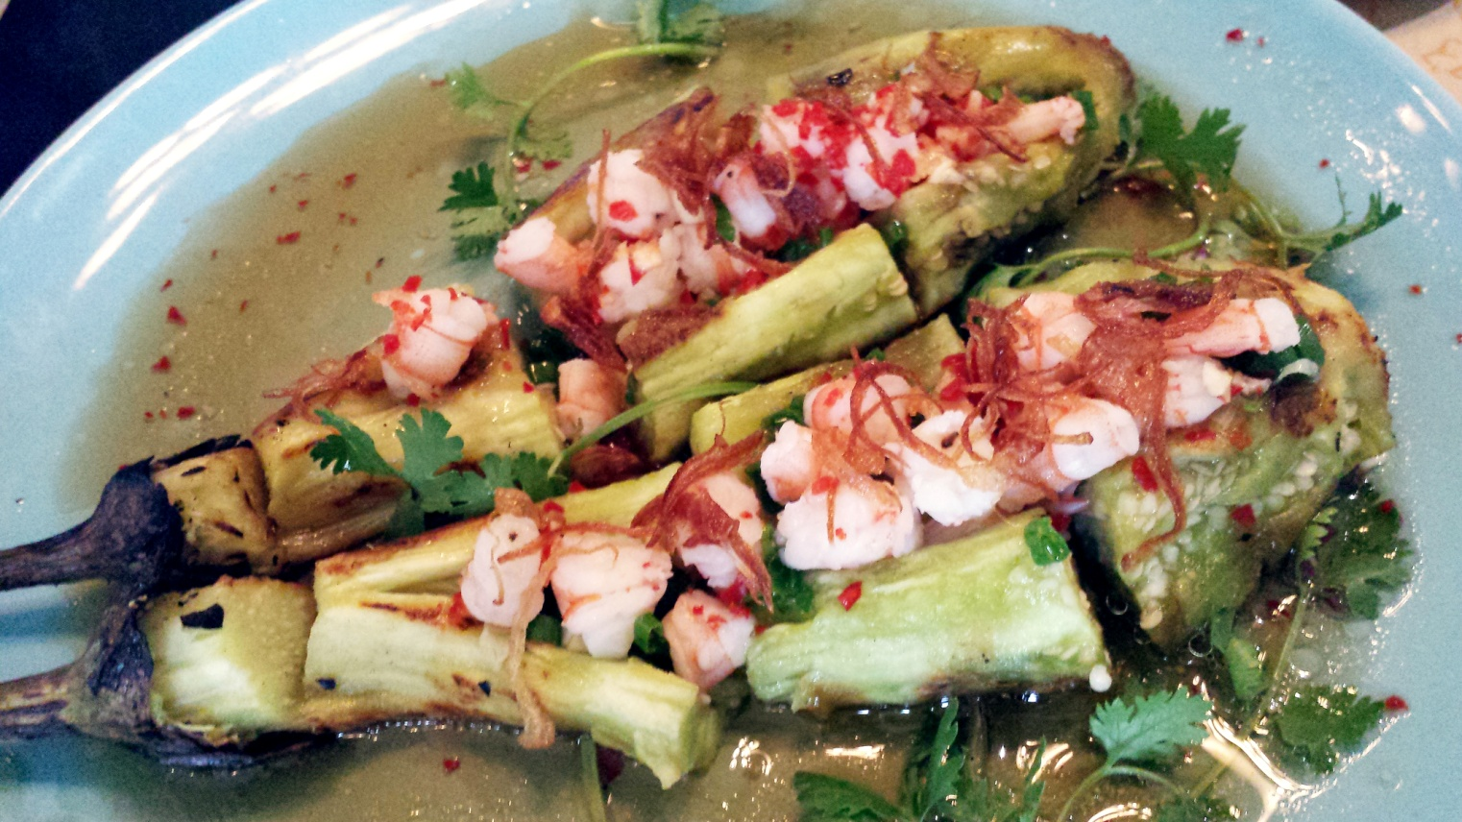
Gỏi – Salads
G1. Gỏi Bò Bóp Thấu 95,000 VND
Beef Salad with Raw Banana,
Star Fruit, Onions, Mint Leaf Salad
G2. Gỏi Ngó Sen Nấm Đông Cô 95,000 VND
Fresh Lotus Root and
Shitake Mushroom Salad
G3. Gỏi Củ Hủ Dừa Tôm 95,000 VND
Hearts of Palm Salad with Shrimp
G1
Món Xào – Vegetables
R1. Rau Sạch Xào Tỏi 65,000 VND
Organic Vegetables Sauteed in Garlic
R2. Rau Sạch Xào Rượu Chuối 65,000 VND
Organic Vegetables Sauteed in Banana Wine
R3. Rau Sạch Xào Bò 85,000 VND
Organic Vegetables Sauteed with Beef
R4. Cà Tím Nướng Mỡ Hành Với Tôm Tươi 70,000 VND
Grilled Eggplant Topped with Shrimp and Green Onions,
Served with Fish Sauce
R4
Giá Chưa Bao Gồm 10% VAT
Prices Are Subject to 10% VAT

Slide 3
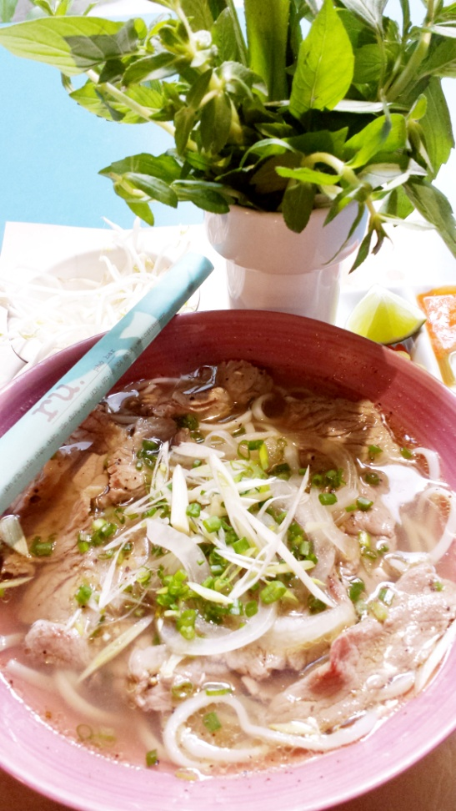
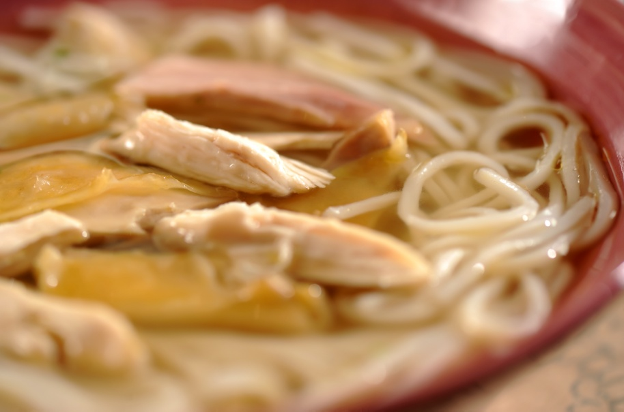
Phở – Rice Noodle Soups
P7
Nhỏ / Small Lớn / Large
P1. Phở với Một Loại Thịt (Tái hoặc Nạm hoặc Bò Viên) 65,000 VND 85,000 VND
Beef Broth Rice Noodle Soup with One Choice of Meat
Rare Beef or Brisket or Meat Balls
P2. Phở Tái Nạm 65,000 VND 85,000 VND
Beef Broth Rice Noodle Soup with Rare Beef & Brisket
P3. Phở Tái Bò Viên 65,000 VND 85,000 VND
Beef Broth Rice Noodle Soup with Rare Beef & Meatballs
P4. Phở Nạm Bò Viên 65,000 VND 85,000 VND
Beef Broth Rice Noodle Soup with Brisket & Meatballs
P5. Phở Tái Nạm Bò Viên 65,000 VND 85,000 VND
Beef Broth Rice Noodle Soup with Rare Beef, Brisket
& Meatballs
P6. Phở Đặc Biệt (Tái, Nạm, Gân, Bò Viên) 75,000 VND 95,000 VND
Beef Broth Rice Noodle Soup with Rare Beef, Brisket
Tendons & Meatballs
P7. Phở Gà 75,000 VND 95,000 VND
Chicken Broth Rice Noodle Soup Served with
Free-Range Chicken
* Lựa chọn tốt cho sức khỏe: bánh phở Gạo Lức, thêm 10,000 VND (tô nhỏ) hoặc 15,000 VND (tô lớn).
* For a healthier option, substitute for Brown Rice Pho Noodles. Small Bowl: 10,000 VND extra. Large Bowl: 15,000 VND extra.
P1
Giá Chưa Bao Gồm 10% VAT
Prices Are Subject to 10% VAT

Slide 4
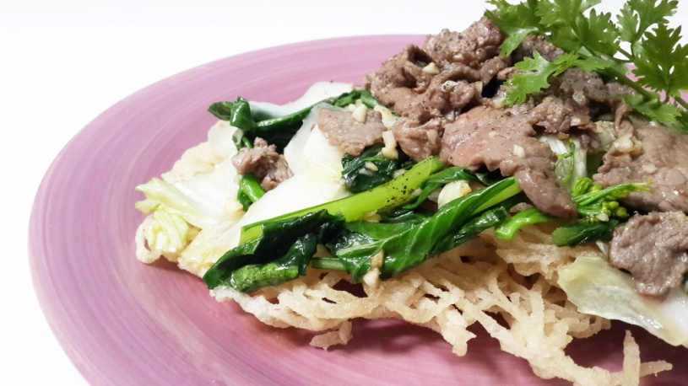
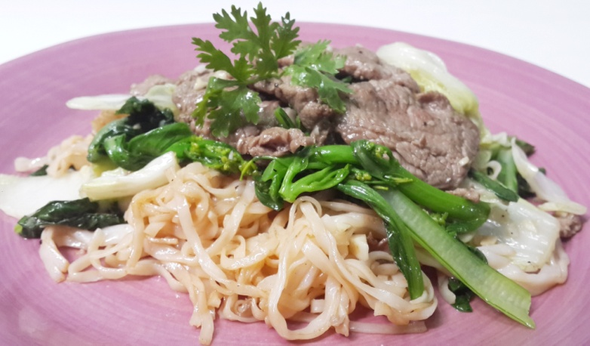
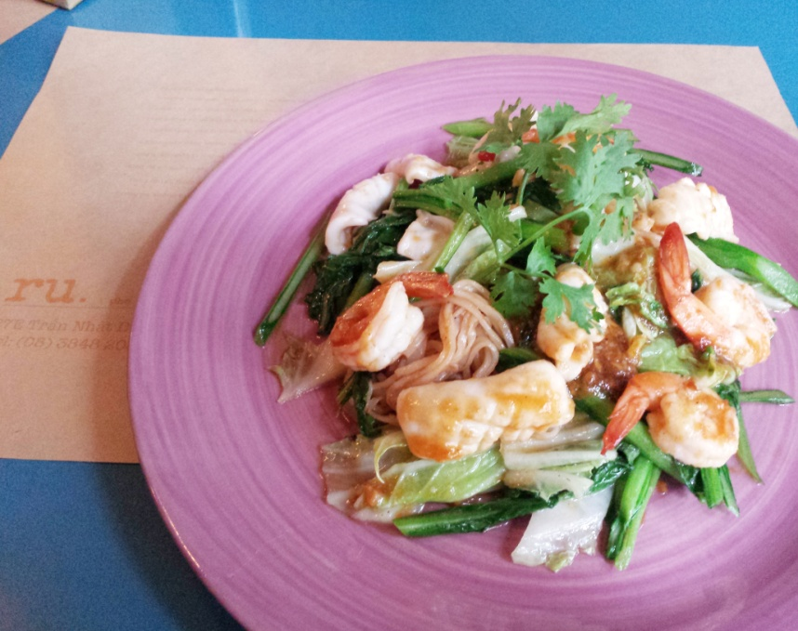
Phở Xào – Rice Noodle Dishes
PX1
PX2
PX1. Phở Xào Bò (Áp Chảo Giòn) 65,000 VND
Crispy Rice Noodle Sauteed with Beef and
Vegetables
PX2. Phở Xào Bò (Áp Chảo Mềm) 65,000 VND
Soft Rice Noodle Sauteed with Beef and
Vegetables
PX3. Phở Xào Hải Sản (Giòn) 95,000 VND
Crispy Rice Noodle Sauteed with Seafood
(Squid, Shrimp)
PX4. Phở Xào Hải Sản (Mềm) 95,000 VND
Soft Rice Noodle Sauteed with Seafood
(Squid, Shrimp)
PX4
* Lựa chọn tốt cho sức khỏe: bánh phở Gạo Lức, thêm 10,000 VND
* For a healthier option, substitute for Brown Rice Pho Noodles. 10,000 VND extra
Giá Chưa Bao Gồm 10% VAT
Prices Are Subject to 10% VAT

Slide 5
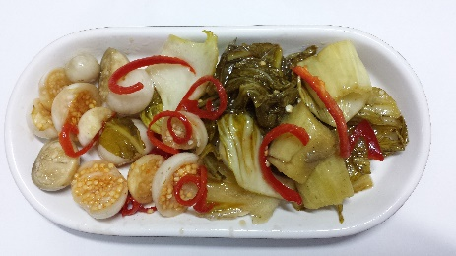
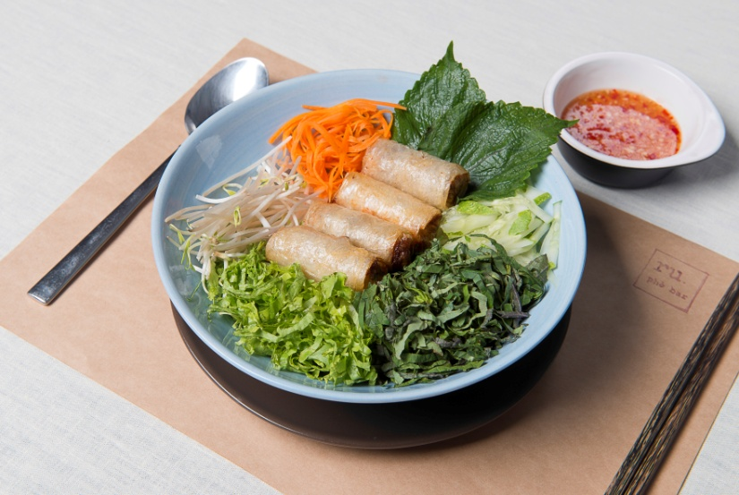
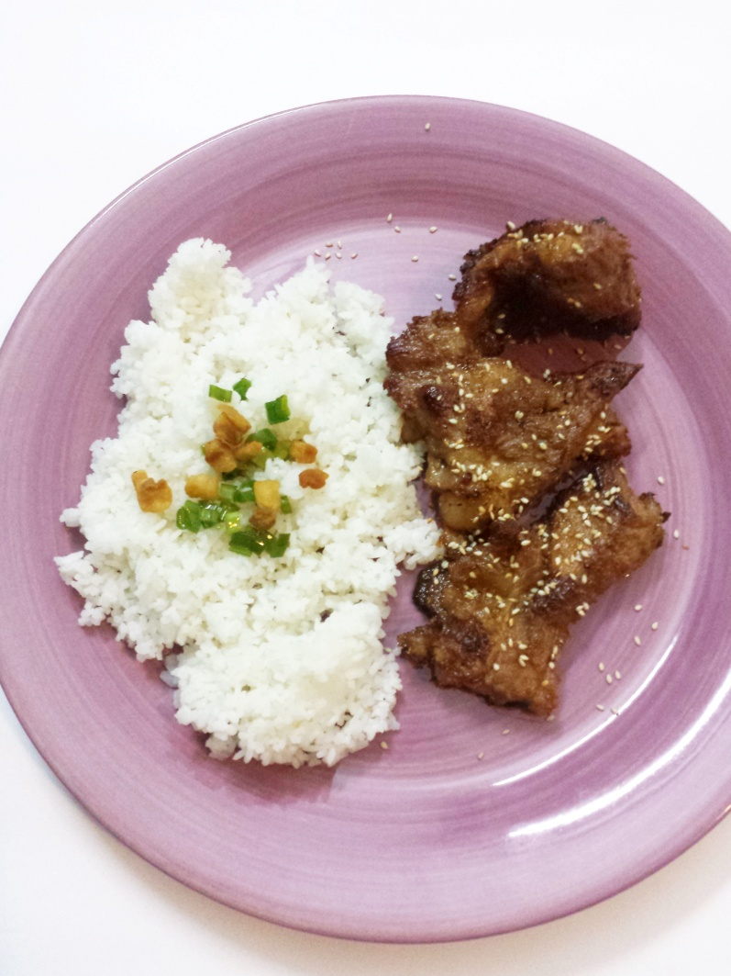
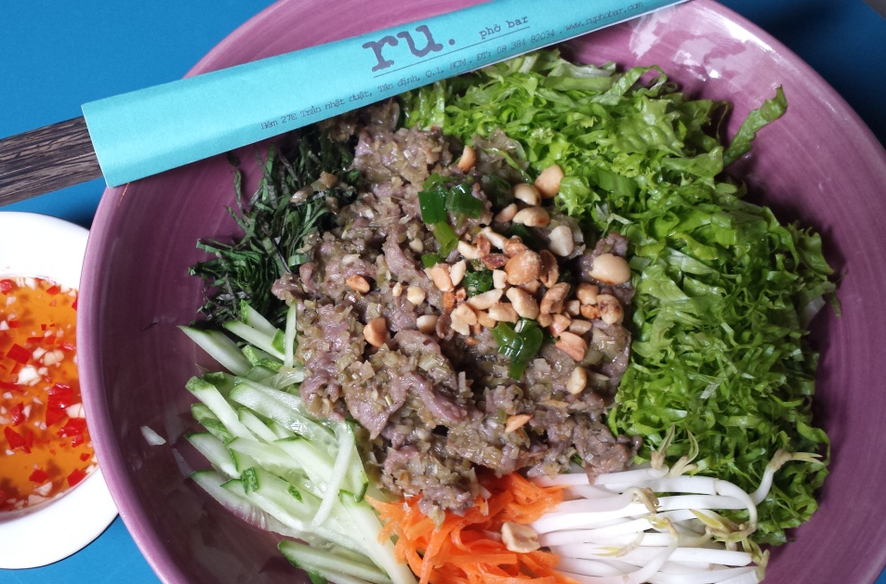
Bún & Cơm – Vermicelli & Rice Dishes
B1. Bún Chả Giò 65,000 VND
Fried Spring Rolls on a Bed of Rice Vermicelli and Fresh Vegetables
(Lettuce, Cucumber, Bean Sprouts, Vietnamese Basil, and Green Onion)
B2. Bún Thịt Bò Xào Sả 69,000 VND
Lemongrass Beef on a Bed of Rice Vermicelli and Fresh Vegetables
(Lettuce, Cucumber, Bean Sprouts, Vietnamese Basil, and Green Onion)
B3. Cơm Tấm Nước Dừa Sườn Nướng 95,000 VND
Grilled Pork Ribs Served with Broken Rice Steamed in Coconut Juice
with a side of Pickled Vegetables
B1
B2
B2
B3
* 2 Cuốn Chả Giò Thêm 20,000 VND
* Add two Fried Spring Rolls to your order for 20,000 VND extra
Giá Chưa Bao Gồm 10% VAT
Prices Are Subject to 10% VAT

Slide 6
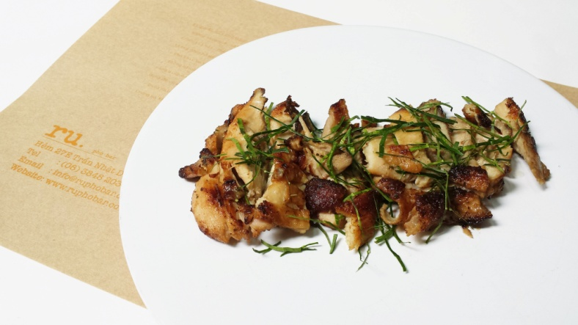
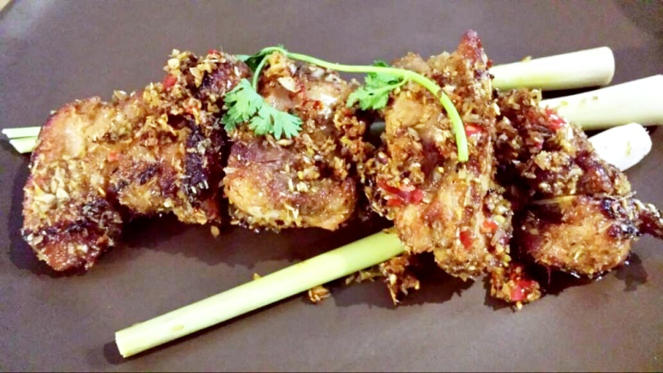
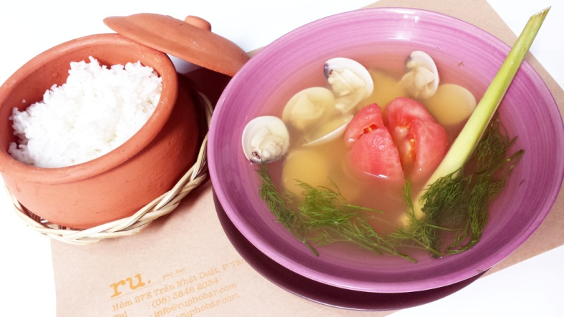
Món Chính – Main Course
Dùng Với Cơm Trắng* / Served with Steamed Rice*
MC1. Gà Nướng Lá Chanh 95,000 VND
Lime Leaf Grilled Chicken
MC2. Sườn Non Chiên Xả Ớt 95,000 VND
Lemongrass and Chili Flavored
Baby Back Ribs
MC3. Thịt Kho Nước Dừa 95,000 VND
Caramelized Braised Pork
Cooked in Coconut Juice
MC4. Cá Kho Tộ 105,000 VND
Caramelized Braised Fish
MC5. Tôm Xóc Muối Tỏi 185,000 VND
Grilled Salted Shrimp with Garlic
* Lựa chọn tốt cho sức khỏe​: ​cơm gạo lứt, thêm 10,000 VND
* For a healthier option, substitute for a bowl of Brown Rice for an
extra charge of 10,000 VND
C1. Canh Rau Sạch Nấu Tôm Tươi 95,000 VND
Fresh Shrimp Soup with
Organic Vegetables
C2. Canh Nghêu Cà Chua Thì Là 95,000 VND
Clam Soup with Dill and
Tomatoes
C3. Canh Chua Cá 105,000 VND
Sweet and Sour Fish Soup
with Vegetables
* Lựa chọn tốt cho sức khỏe​: ​cơm gạo lứt, thêm 10,000 VND
* For a healthier option, substitute for a bowl of Brown Rice for an extra charge of 10,000 VND
SO1. Thố Cơm Trắng / Clay Pot of Steamed Jasmine Rice 15,000 VND
SO2. Thố Cơm Gạo Lứt / Clay Pot of Brown Rice 20,000 VND
(Không có nêm hoặc có trộn muối và tỏi)
(Unseasoned or Mixed with Salt and Sauteed Garlic)
MC1
MC2
Món Canh – Soup
Dùng Với CơmTrắng* / Served with Steamed Rice*
C2
Món Thêm – Side Orders
Giá Chưa Bao Gồm 10% VAT
Prices Are Subject to 10% VAT

Slide 7
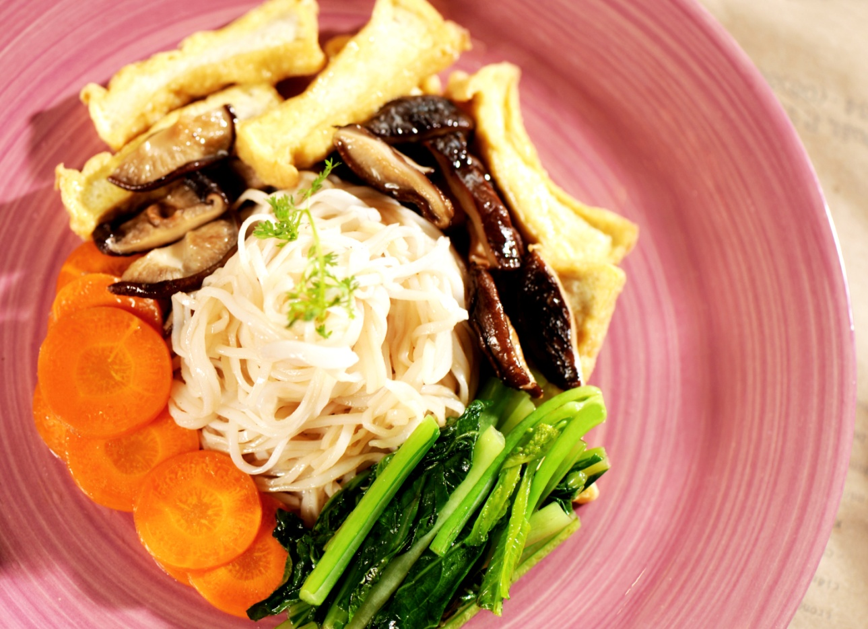
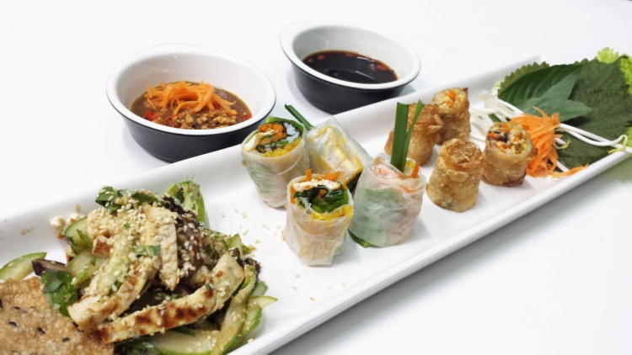
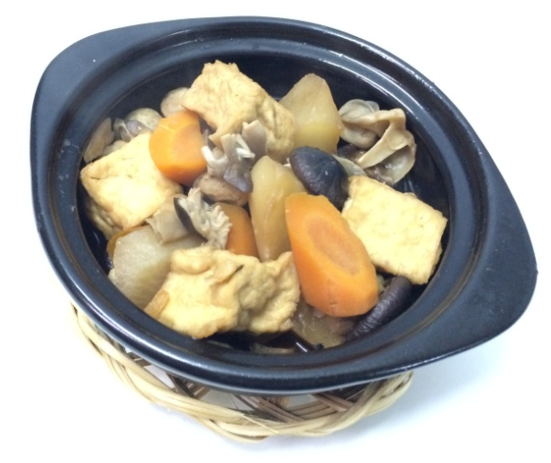
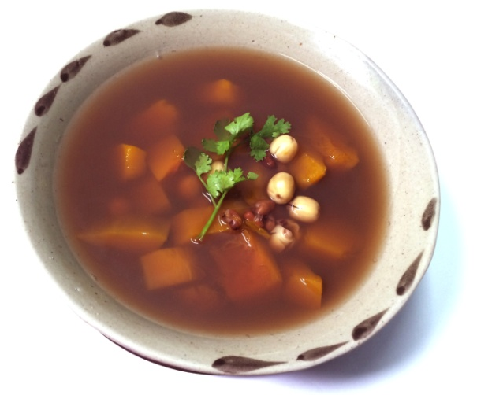
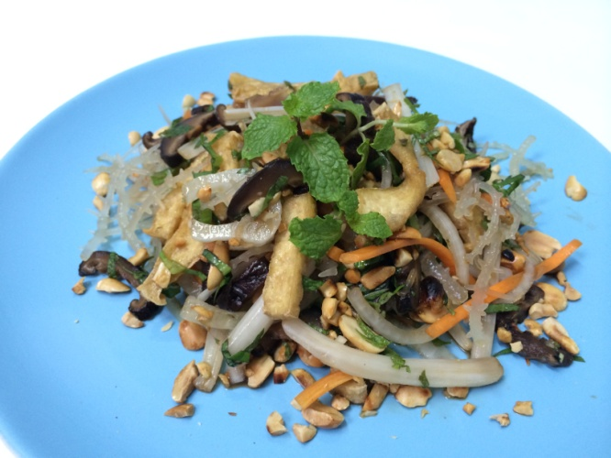
Món Chay – Vegetarian Dishes
V6
V1
V1. Món Khai Vị Chay / Ru Vegetarian Sampler 105,000 VND
Gỏi Dưa Leo Đậu Hủ Nướng
Gỏi Cuốn Chay (2 Cuốn)
Chả Giò Chay (2 Cuốn)
Cucumber and Grilled Tofu Salad in Sesame Dressing
Vegetarian Spring Rolls (2 Rolls)
Vegetarian Fried Rolls (2 Rolls)
V2. Gỏi Cuốn Chay (5 Cuốn) 65,000 VND
Ru Vegetarian Spring Rolls (5 Rolls)
With Tofu, Shitake Mushroom, Lettuce, Carrot,
Vietnamese Basil, and Chives in Rice Paper Wrap
V3. Gỏi Dưa Leo Đậu Hủ Nướng 75,000 VND
Cucumber and Grilled Tofu Salad in
Sesame Dressing
V4. Gỏi Rau Câu Chân Vịt​ 75,000 VND
Agar Agar and Vegetables Salad
V5. Phở Xào Chay (Áp Chảo Giòn) 65,000 VND
Vegetarian Crispy Noodle Sauteed
with Tofu and Vegetables
V6. Phở Xào Chay (Áp Chảo Mềm) 65,000 VND
Vegetarian Soft Noodle Sauteed
with Tofu and Vegetables
V7. Canh Bí Đỏ Hầm Hạt Sen Đậu Đỏ 75,000 VND
Pumpkin, Red Beans and Lotus Seeds Soup
Dùng Với CơmTrắng* / Served with Steamed Rice*
V8. Nấm Rơm Kho Tiêu với Nước Dừa Xiêm​ 75,000 VND
Straw Mushrooms Braised in Coconut Juice​
Dùng Với CơmTrắng* / Served with Steamed Rice*
* Lựa chọn tốt cho sức khỏe​: ​cơm gạo lứt, thêm 10,000 VND
* For a healthier option, substitute for a bowl of Brown Rice for an extra charge
of 10,000 VND
Nấm Rơm Kho Tiêu với Nước Dừa Xiêm​
Straw Mushrooms braised in Coconut Juice​
V8
V7
V4
Giá Chưa Bao Gồm 10% VAT
Prices Are Subject to 10% VAT

Slide 8
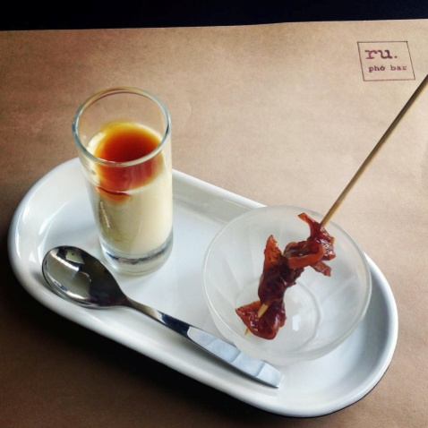
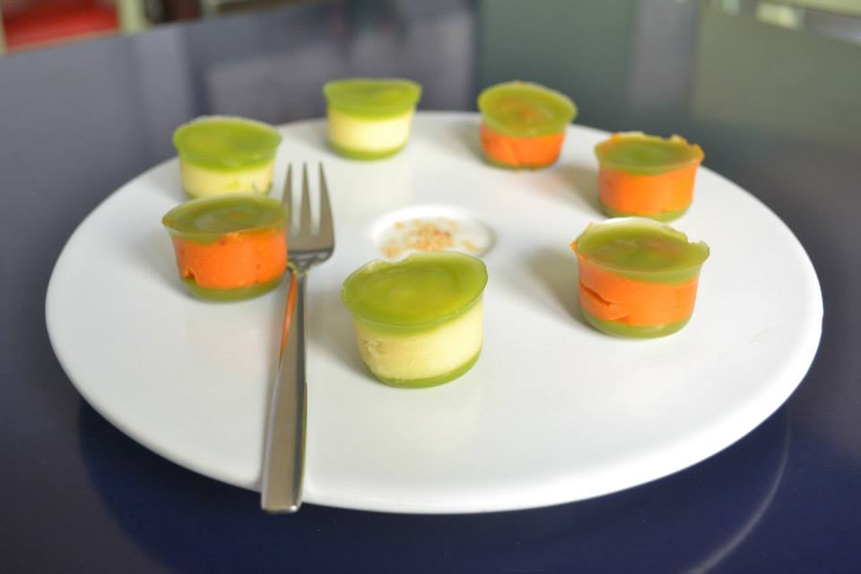
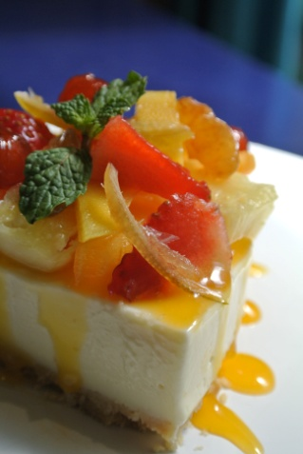
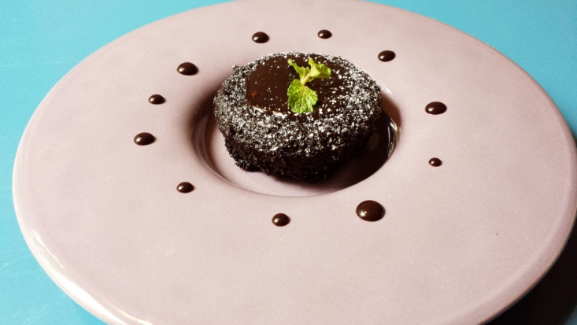
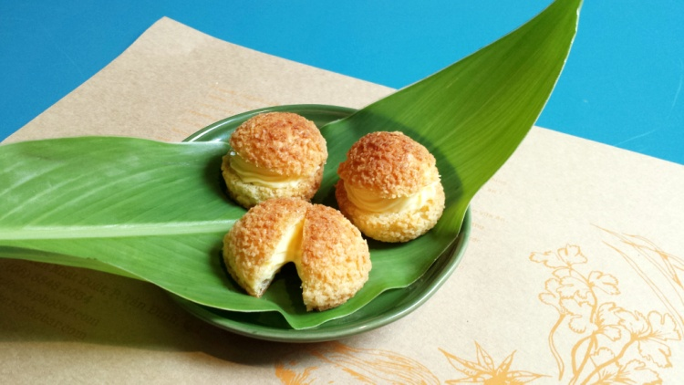
Tráng Miệng – Homemade Desserts
TM1
TM6
TM3
TM1. Bánh Flan Rượu Gạo 35,000 VND
Rice Wine Flavored Flan
TM2. Chè Tàu Hủ Lạnh 30,000 VND
Chilled Tofu Served with Caramelized
Ginger Syrup and Coconut Milk
TM3. Bánh Phô Mai Tàu Hủ (Lát) 59,000 VND
Cream Cheese - Tofu Cake (Slice)
TM4. Bánh Sô Cô La Nóng Không Bột 45,000 VND
"Chocolate Damnation"
Flourless Cake Made from Local Chocolate
TM5. Bánh Xu Kem Chanh Dây 35,000 VND
Cream Puff Filled with Passion Fruit Filling
TM6. Bánh Da Lợn 38,000 VND
Tapioca Layered Cake with Coconut Milk
TM7. Dĩa Trái Cây 60,000 VND
Plate of Fruits
TM4
TM5
Giá Chưa Bao Gồm 10% VAT
Prices Are Subject to 10% VAT

Slide 9

Thực Uống – Drinks
Bia / Beers
D1. Biere Larue 30,000 VND
D2. 333 30,000 VND
D3. Saigon Special 40,000 VND
D4. Tiger 40,000 VND
D5. Sapporo 45,000 VND
D6. Heineken 50,000 VND
Nước Ngọt / Soft Drink
S1. Coca Cola 25,000 VND
S2. Coke Kiêng / Diet Coke 25,000 VND
S3. 7-UP 25,000 VND
S4. Soda 25,000 VND
Nước Suối / Mineral Water
S5. Nước Suối Không Có Gas 18,000 VND
Regular Mineral Water
S6. Nước Suối Có Gas 45,000 VND
Sparkling Mineral Water
Nước Trái Cây 45,000 VND
Squeezed on the Spot
Juice
N1. Cam Tươi Ép / Orange
N2. Dưa Hấu Ép / Watermelon
N3. Tắc Ép / Kumquat
N4. Thơm Ép / Pineapple
N5. Cà-rốt Ép / Carrot
N6. Bưởi Ép / Pomelo
N7. Chanh Ép / Lemon
N8. Nước ép Tổng Hợp (Tự Chọn) 50,000 VND
Mixed Juice
N9. Trái Dừa Tươi 40,000 VND
Fresh Coconut
N5
Giá Chưa Bao Gồm 10% VAT
Prices Are Subject to 10% VAT

Slide 10


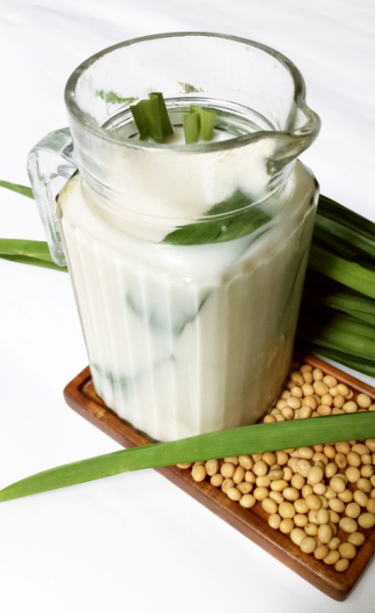
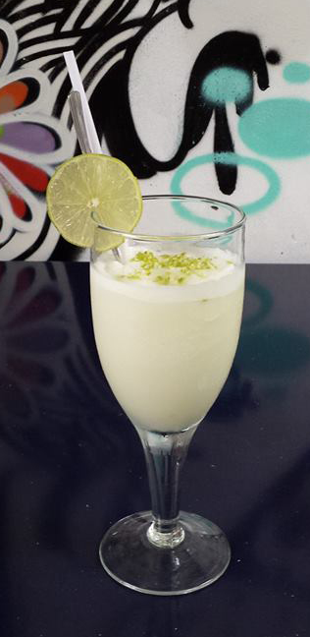
Thực Uống – Drinks
RS1
RS2
H1
RS6
Ru Đặc Biệt / Ru Specials
RS1. Chanh Muối Ru / Ru Pickled Lemon juice 40,000 VND
RS2. Trà Chanh Đá Ru / Ru Iced Tea 40,000 VND
RS3. Sài Gòn Cooler / Mint, Lemon, Picked Lemon, and Coke 40,000 VND
RS4. Mint Frizz / Blended Mint, Lemon, and Sprite 40,000 VND
RS5. Ru Giải Độc (Khổ Qua, Thơm, Tắc, Mật Ong) 45,000 VND
Ru Elixir (Bitter Melon, Pineapple, Kumquat, and Honey)
RS6. Sinh Tố Chanh / Lemon Smoothie 48,000 VND
Thức Uống Nấu ở Nhà / Homemade Drinks Ly (Glass) / Bình (Carafe)
H1. Sữa Đậu Nành Nguyên Chất / Pure Soy Milk 25,000 VND/ 45,000 VND
H2. Sữa Đậu Nành Đậu Phộng 30,000 VND/ 55,000 VND
Soy Milk Blended with Roasted Peanut
H3. Rau Má Nguyên Chất / Pure Pennyworth Juice 25,000 VND/ 45,000 VND
H4. Rau Má Đậu Xanh 30,000 VND/ 55,000 VND
Pennyworth Juice Blended with Mung Bean
H5. Mía Lau Nguyên Chất 25,000 VND/ 45,000 VND
Brewed Sugarcane Imperatae, Rock Sugar, Arrow Roots,
Water Chestnut
H6. Rau Má Với Nước Dừa Tươi (Bình) 65,000 VND
Pennyworth Juice Mixed with Fresh Coconut Juice (Carafe only)
Giá Chưa Bao Gồm 10% VAT
Prices Are Subject to 10% VAT

Slide 11
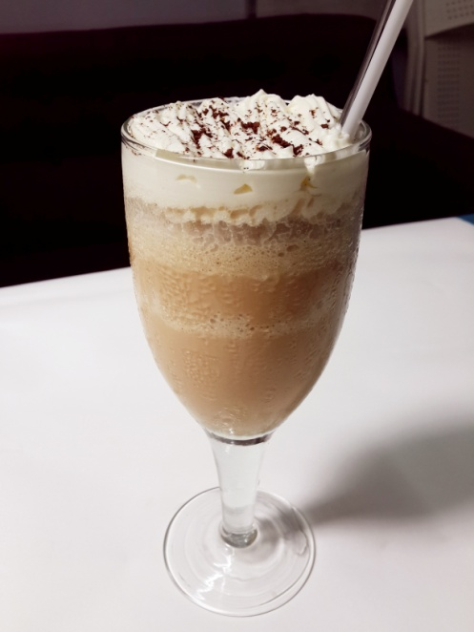
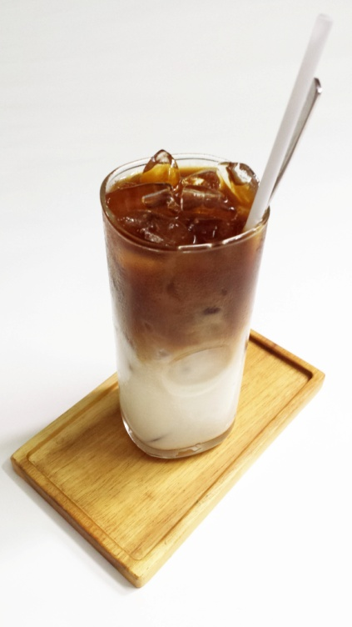
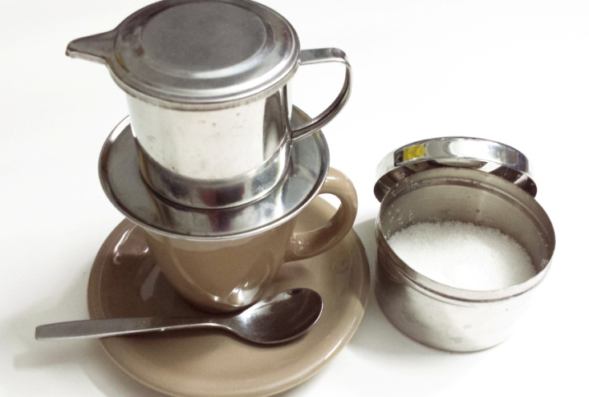
Thực Uống – Drinks
CP4
CP5
CP3
Cà Phê Việt Nam / Vietnamese Coffee
Xuất xứ: Lâm Đồng, Chọn Lọc, Pha Phin
Selected Origin: Lâm Đồng, Drip Coffee
CP1. Cà Phê Đen Đá 32,000 VND
Iced Black Coffee
CP2. Cà Phê Sữa Đá 37,000 VND
Iced Milk Coffee (with Condensed Milk)
CP3. Cà Phê Đá​ ​Với Sữa Tươi 45,000 VND
Iced Cafe Latte (with Fresh Milk)
CP4. Cà Phê Nóng 32,000 VND
Hot Coffee
CP5. Cà Phê Đá Xay (với Sữa Đặc hoặc Sữa Tươi) 65,000 VND
Phủ Kem Sữa Tươi và Bột Sô Cô La
Ice-Blended Vietnamese Coffee (with Condensed or Fresh Milk)
Topped with Whipped Cream and Chocolate Powder
Trà Việt Nam / Vietnamese Tea
T1. Ấm Trà Ôlong 60,000 VND
Oolong Tea Pot
T2. Ấm Trà Hoa Cúc 60,000 VND
Chrysanthemum Tea Pot
T3. Lá Chè Xanh Gừng Ly (Glass) / Bình (Carafe)
Fresh Tea Leaves with Ginger 15,000 VND/ 25,000 VND
Giá Chưa Bao Gồm 10% VAT
Prices Are Subject to 10% VAT

